Slide 1

Chi: A Scalable & Programmable Control Plane for Distributed Stream Processing
Luo Mai, Kai Zeng, Rahul Potharaju, Le Xu, Steve Suh, Shivaram Venkataraman, Paolo Costa, Terry Kim, Saravanan Muthukrishnan, Vamsi Kuppa, Sudheer Dhulipalla, and Sriram Rao Imperial College London, Microsoft and UIUC
luo.mai11@imperial.ac.uk

Slide 2


Background
Stream processing system has many critical production usages today
Sources
Stream processing system
Real-time dashboard
Event
Machine learning
Stateful operator
Interactive Debugging

Slide 3
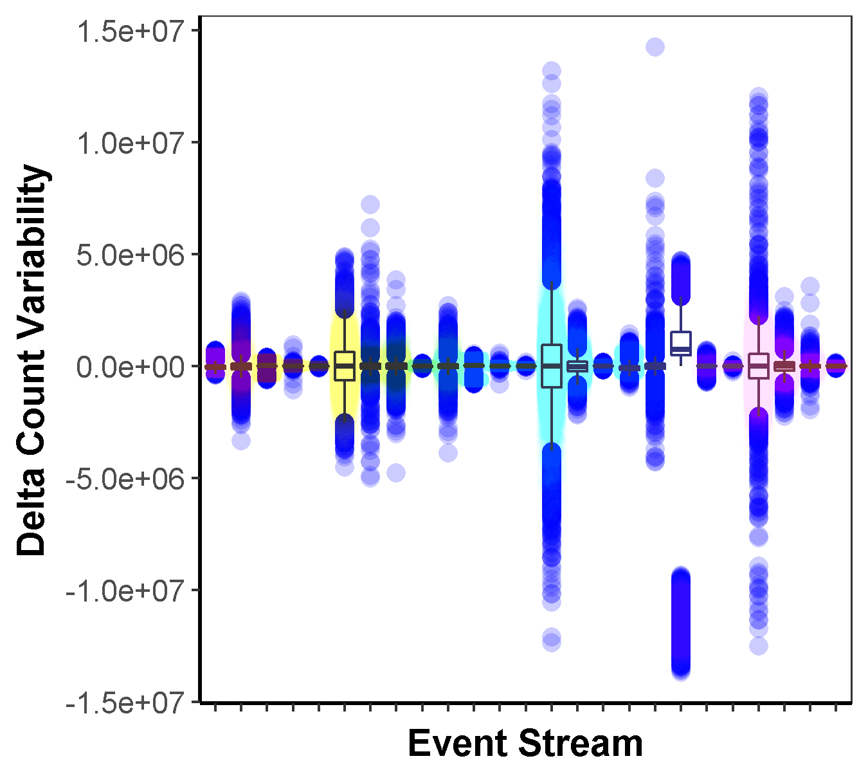
Production ingestion workloads shows large variability
Problem
>10 millions
No common pattern
Variability of Event Count (minute)

Slide 4
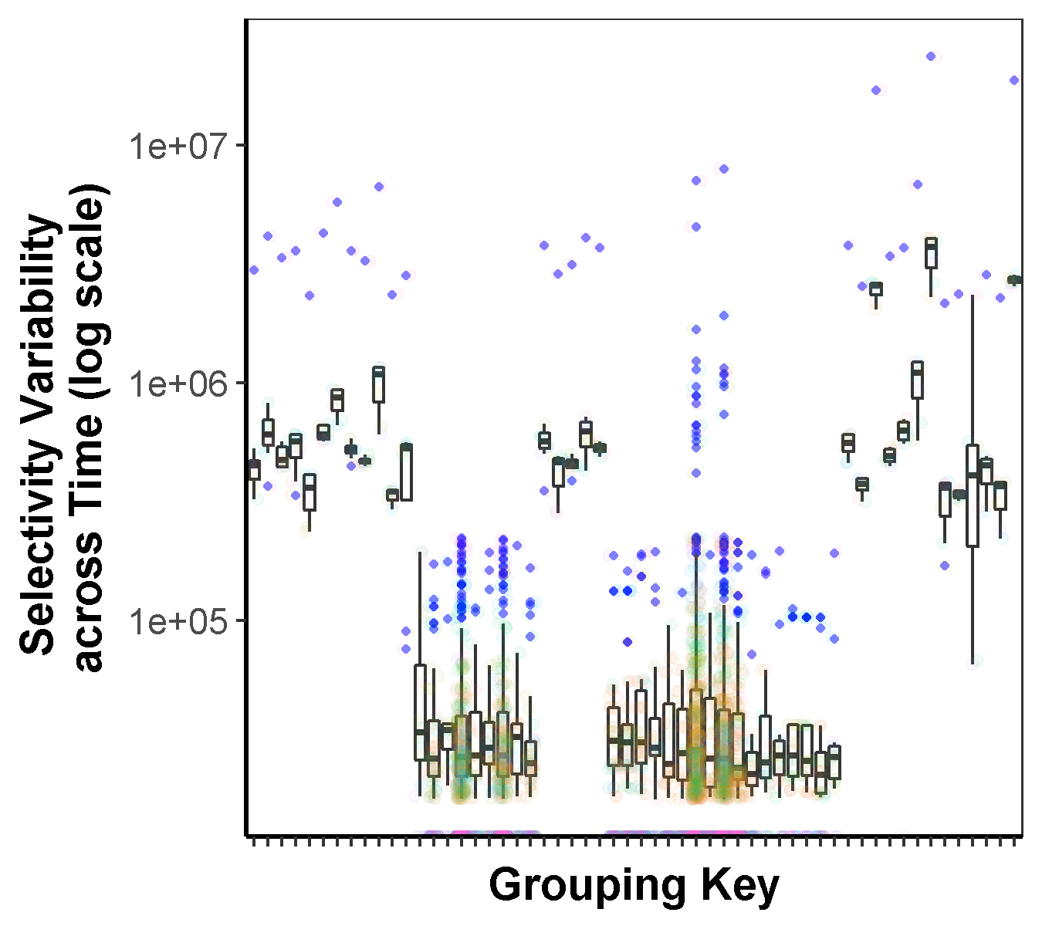
High-degree data skew is common in real-world queries
Problem
~ 10 millions
Event Count (minute)
~ 0.1 millions

Slide 5
Goals
Scalability and flexibility are keys to control plane
Global consistency
Consistent distributed state updates through barriers
Low data plane overhead
Programmability
Individual user service requirements and resource constraints
Control plane
Modification
Monitoring
Topology
Hashing scheme
Data plane

Slide 6
State-of-the-art
Continuous monitoring and modification is challenging
High modification cost
Flink and Storm
Freezing-the-world
Drizzle [SOSP’17] and Spark
Modifications on barriers
Centralized masters
Limited extensibility
Constant scheduling overhead and delay
High cost in latency and availability

Slide 7

Design
Chi -: novel control plane that embeds operations in data plane
Reactive functions in state machine
Punctuation as control message
Travelling with data
Channel barrier
Chi novel designs
Distributed control loops
Non-blocking dataflow barrier
Extensible state machine
Controller
OnInit
Punctuation
OnBegin
OnNext
OnComplete
OnDispose
“Moving” barrier

Slide 8
Example: Monitoring
Control message
1
5
2
User case
Monitor group key and latency
Move heavy groups to new operators if latency is high
Key properties
Low overhead
High scalability
4
Reducer
3
Mapper

Slide 9
Example: Modification
1
User case
Monitor group key and latency
Move heavy groups to new operators if latency is high
Key properties
Low overhead
High scalability
Global consistency
6
New reducer
5
State dependency
2
4
Old reducer

Slide 10
Chi in Action
Chi enables large stateful streaming systems to adapt quickly

Slide 11
Chi in Action
Chi shows low overhead in data processing latency

Slide 12
Effects of control and data plane overlaps
Does busy control plane affect data plane?
4–10% extra latency with 100 controls / second
Does busy data plane limit control plane?
~300ms control latency (100 controls / second) with 220 millions events / second
Is control plane scalable?
~75ms control latency for 8192 dataflow nodes
Evaluation
Control messages has low overhead in data processing latency

Slide 13
Summary
Chi enables online monitoring and modification to streaming systems
Global consistency
Programmability
Low overhead
Chi opens up many research opportunities
System self-regulation
Multi-tenant scheduling
Online query and runtime optimization
Many more …
The awesome team I interned in at Microsoft is hiring! Please contact rapoth@microsoft.com if you are interested.

Slide 15
Effects of control and data plane overlaps
Does busy control plane affect data plane?
4–10% extra latency with 100 controls / second
Does busy data plane limit control plane?
~300ms control latency (100 controls / second) with 220 millions events / second
Is control plane scalable?
~75ms control latency for 8192 dataflow nodes
Evaluation
Embedding control messages does not add noticeable data message latency

Slide 16
Effects of control and data plane overlaps
Does busy control plane affect data plane?
4–10% extra latency with 100 controls / second
Does busy data plane limit control plane?
~300ms control latency (100 controls / second) with 220 millions events / second
Is control plane scalable?
~75ms control latency for 8192 dataflow nodes
Evaluation
Control plane can easily scale with data plane

Slide 17

Design
Chi - novel control plane that embeds its operations in scalable data plane
Programmable state machine
Punctuation as control message
Flow with tuples
Travel in FIFO channel
Execute asynchronously
Chi novel designs
Control loop
Asynchronous control barrier
State machine with easy-to-extend functions
Controller
OnInit
Punctuation
OnBegin
State
OnNext
OnComplete
“Moving” barrier
OnDispose

Slide 18
Requirements
Enabling continuous monitoring and dynamic reconfiguration
SELECT COUNT(s), s.area_code FROM click_streams AS s
TUMBLE WINDOW s.timestamp BY 60
GROUP BY s.area_code
Policy
Policy
Policy
Online monitor
G3: Intuitive programming interface
Control plane
G3: Low-latency
feedback-loop
G1: Barrier guarantee
Online reconfigure
Parallelism
Batch size
Hashing scheme
Conf. #2
Conf. #1

Slide 19
Goal
Enabling continuous monitoring and online reconfiguration
Control plane
SELECT COUNT(s), s.area_code FROM click_streams AS s
TUMBLE WINDOW s.timestamp BY 60
GROUP BY s.area_code
Online parameter reconfiguration
Feedback-loop
Continuous monitoring
Batch size
Topology
Hashing scheme
Data plane

Slide 20

Key idea
Embed control plane in data plane
Policy
Policy
Policy
[Punctuation / watermark]
Special data events for notification
Travel with data events -> low overhead
Travel asynchronously -> no lock
Travel in FIFO channel -> channel barrier
[Potential benefits]
Piggyback control information in punctuations
Extending punctuations to be control messages to run both monitoring and reconfiguration
Coordinate control message propagation
Consolidating channel barrier as dataflow barrier
Controller as stream operators
Reusing programming and scaling-out techniques
Control plane
Start control
Complete control
Control state
Punctuation
Dataflow barrier

Slide 21
Runtime
Guarantee ”freeze-the-world” update through asynchronous execution
[Control life-cycle steps]
Start control with a meta topology including data, state and control dependency
Generate operator control configurations and piggyback into control message
Broadcast messages to dataflow leaves
Leaves record input channel sequence, run control actions, and broadcast messages downstream
Operator blocks input channel once receiving a control message (if barrier is required)
Operator perform control actions when receiving control messages from all inputs
Operator broadcast control messages to all downstream (and unblock inputs if need)
Controller do post-control actions when receiving messages from all dataflow roots
1
2
8
3
Controller
4
New operator
Control dependency
5
State dependency
7
6
Meta topology

Slide 22
Runtime
Guaranteeing global barrier semantic through decentralized execution
[Decentralized execution]
Operator knows all old data are processed if all parents mark the end by control messages
Operator reconfigure itself to process new data
Operator notifies dependents the end of old data
[Execution sequence]
Computation dependency
State dependency
Control dependency
[Blocking control messages]
Block channel if receiving control message from parent
Unblock inputs when notifying dependents
Operator
Dependents
Parents

